Slide 1


Student Portal
Presented To:
Mr. Kazi Hasnayeen Emad
Lecturer
Green university of Bangladesh
Presented By:
Pritam Saha Turja
ID : 221002115
Department Of CSE
Green University Of Bangladesh
Student Portal

Slide 2

Outlines
Introduction
Objective
Motivation
Features
Tools and Technologies
Implementation
Result
Future Scope of Work
Conclusion
Student Portal
2

Slide 3
Introduction
The Student Portal Web Application is a complete platform that aims to simplify and improve students academic experiences. This application has a straightforward and user-friendly design .
Student Portal
2

Slide 4
Objectives
User-Friendly Interface
Centralized System
Data Accuracy and Security
Scalability
Responsiveness
Student Portal
2

Slide 5
Motivation
The reason for building the Student Portal Web Application derives from the growing need for digital academic administration solutions, as well as the desire to simplify students academic experiences.
Student Portal
2

Slide 6
Features
Admin Dashboard
About Section
Contact Section
Secured Student Login
Student Dashboard
Result
Courses
Billing
Logout
Student Portal
2

Slide 7
Tools and Technologies
Computer/Pc
Notepad
VS Code
Latex
HTML,CSS,PHP, MySQL
XAMPP
Student Portal
2

Slide 8
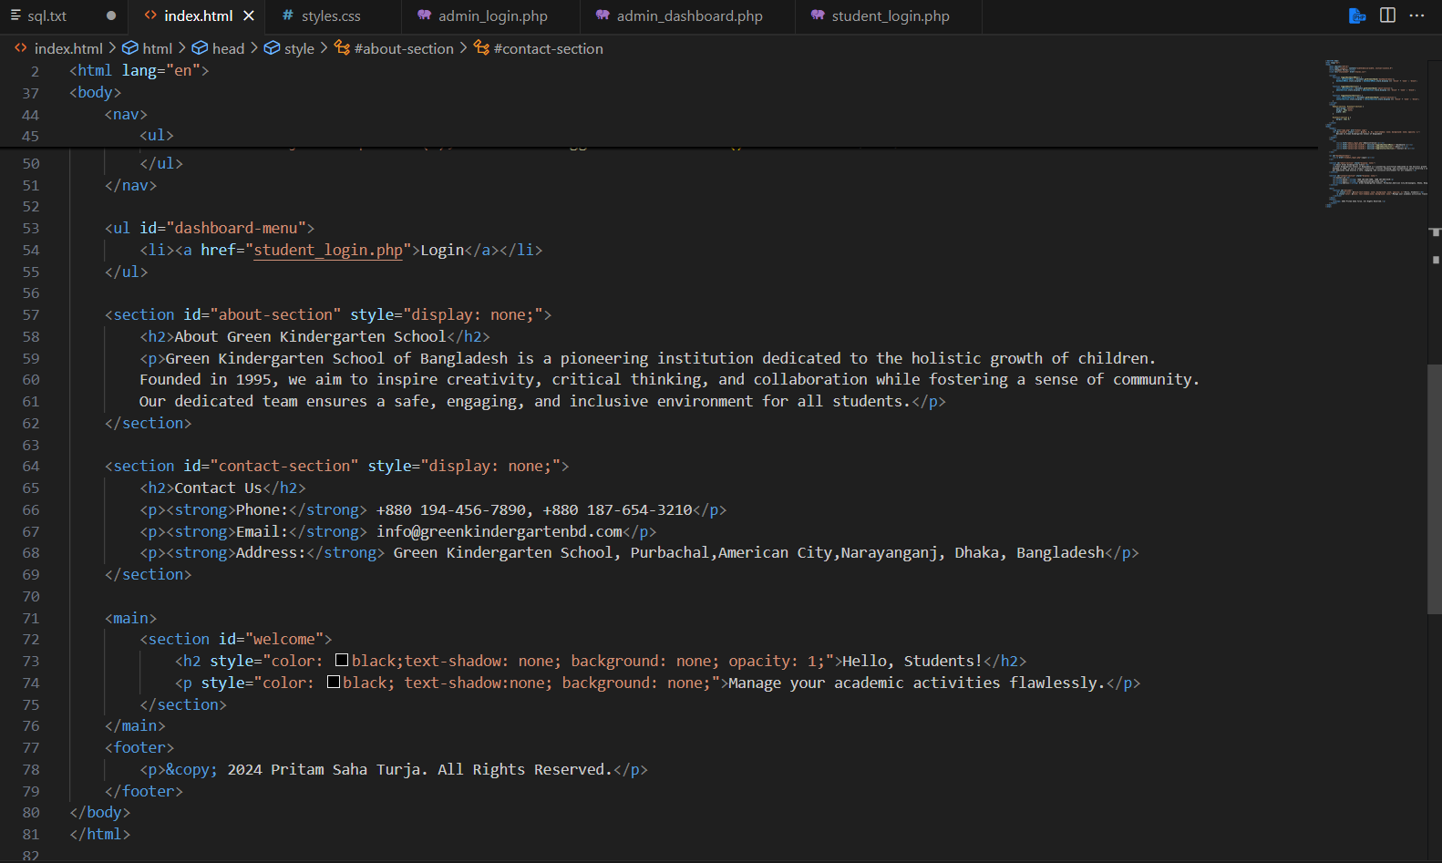
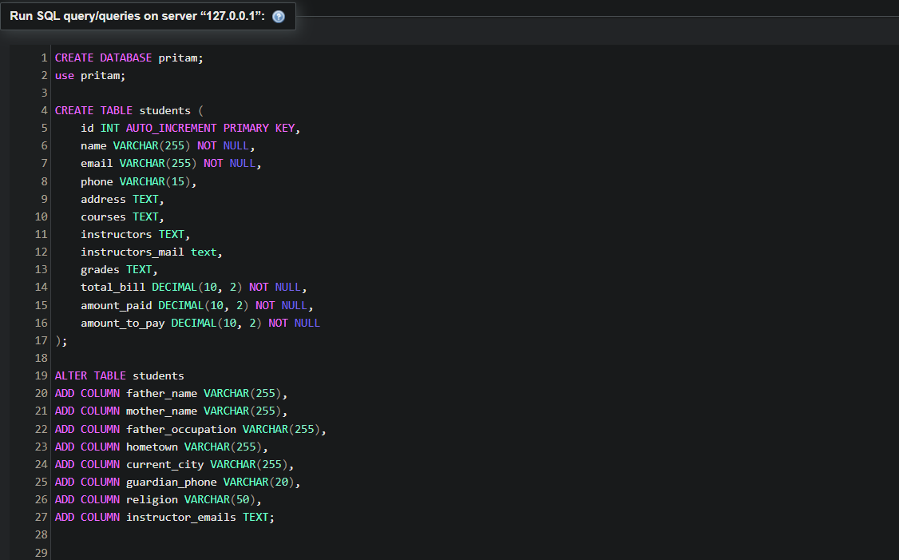
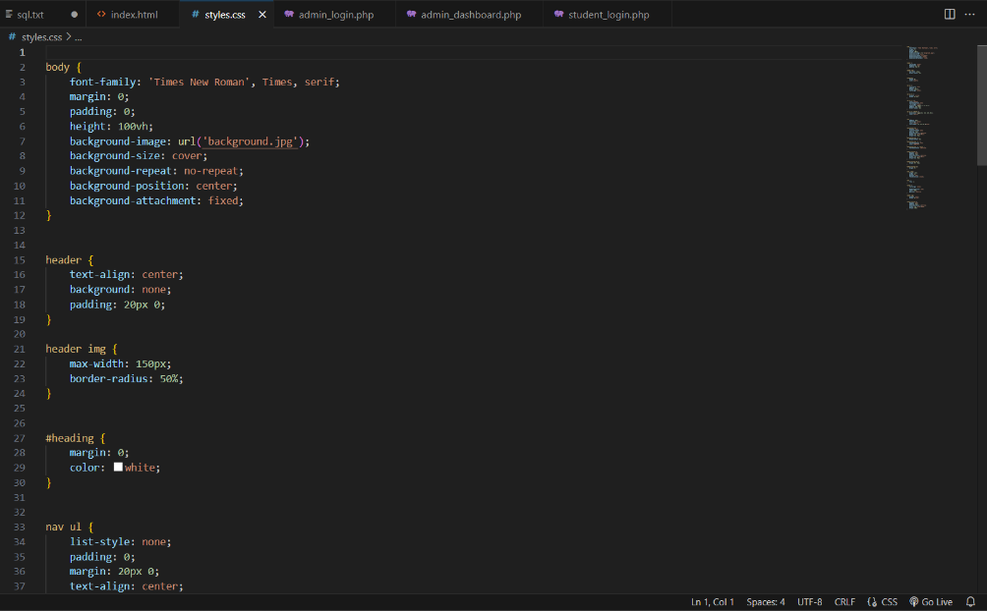
Implementation(1\2)
Source Code snapshot:
Figure 1: MySQL query for the database
Figure 2: HTML , CSS for the homepage structure and design
Student Portal
2

Slide 9
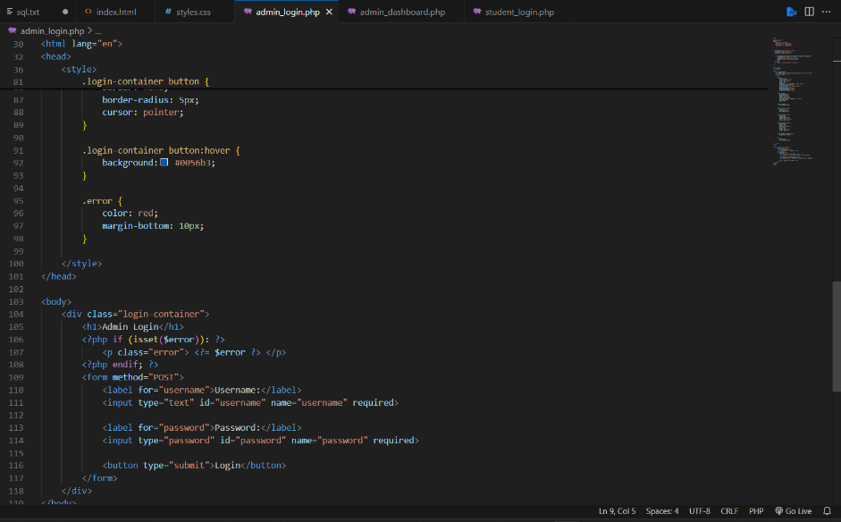
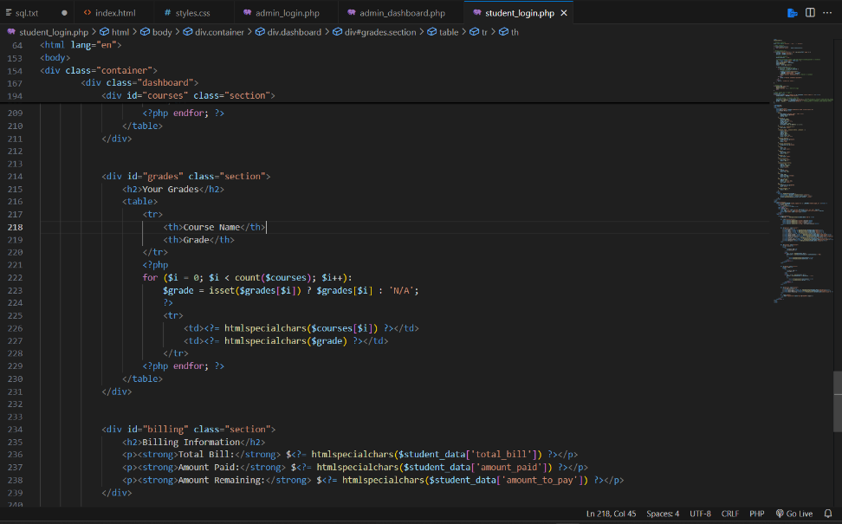
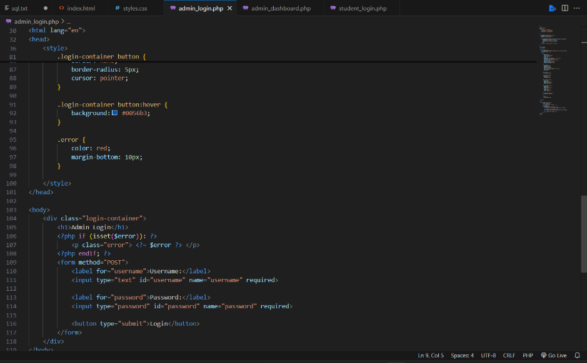
Implementation(2\2)
Figure 3: Student Login
Figure 4: Admin login and admin dashboard
Student Portal
2

Slide 10
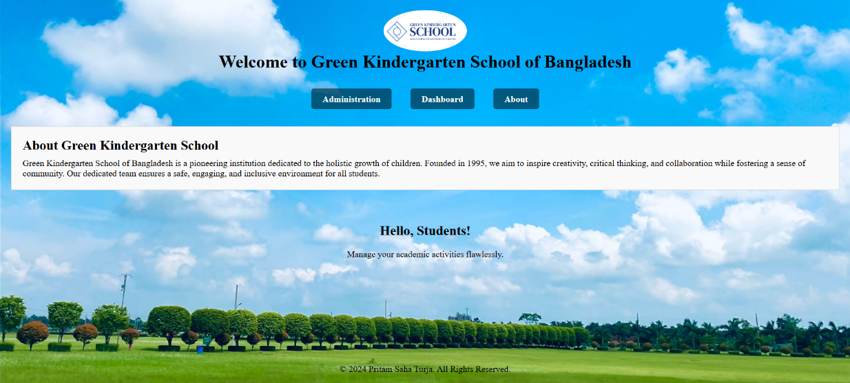
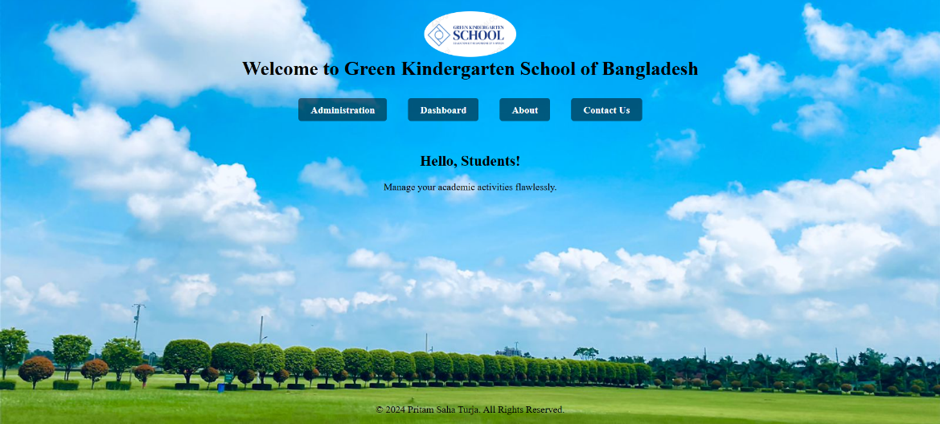

Result(1\5)
Figure 5: Homepage
Figure 6: About and contact section
Student Portal
2

Slide 11
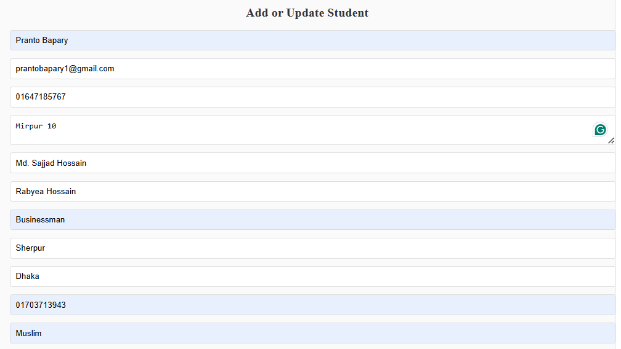
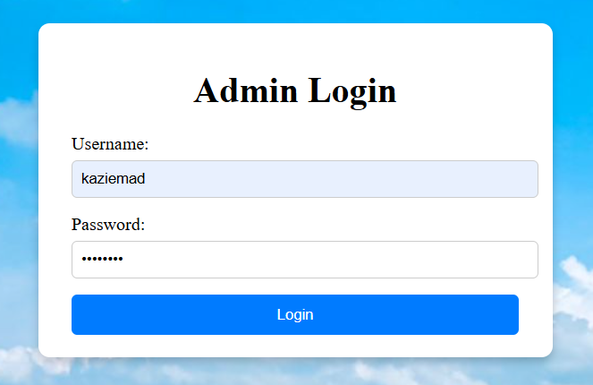
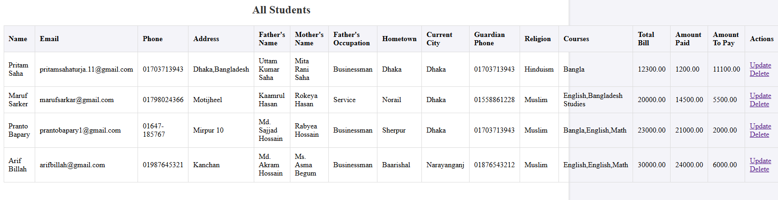
Result(2\5)
Figure 7: Admin Login
Figure 8:Add students information and showing all students records
Student Portal
2

Slide 12
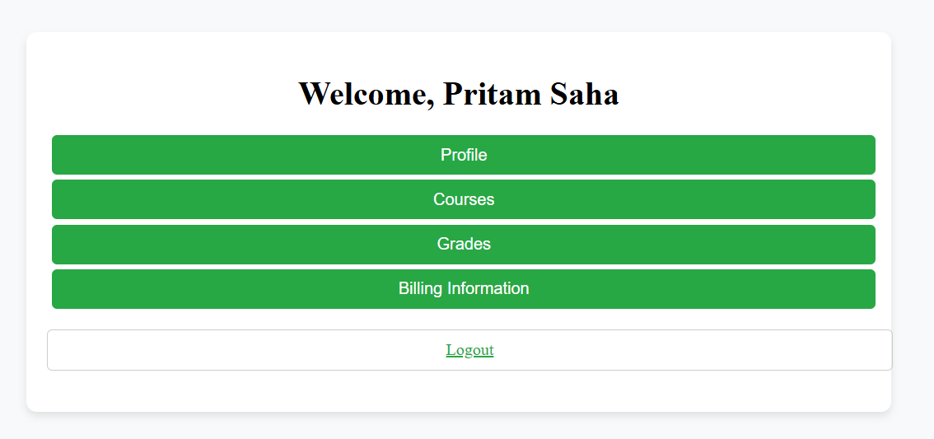
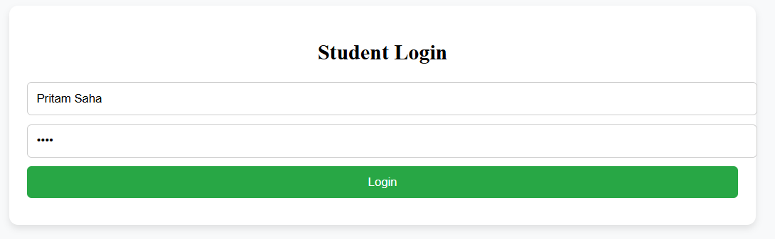
Result(3\5)
Figure 9: Student Login
Figure 10: Student Dashboard
Student Portal
2

Slide 13
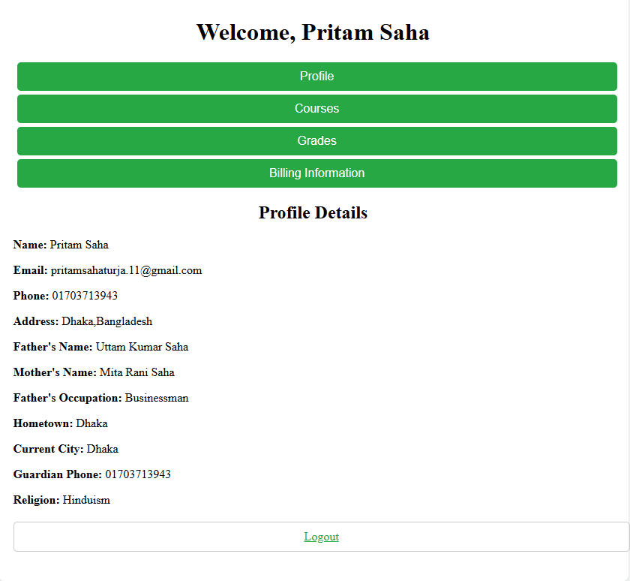
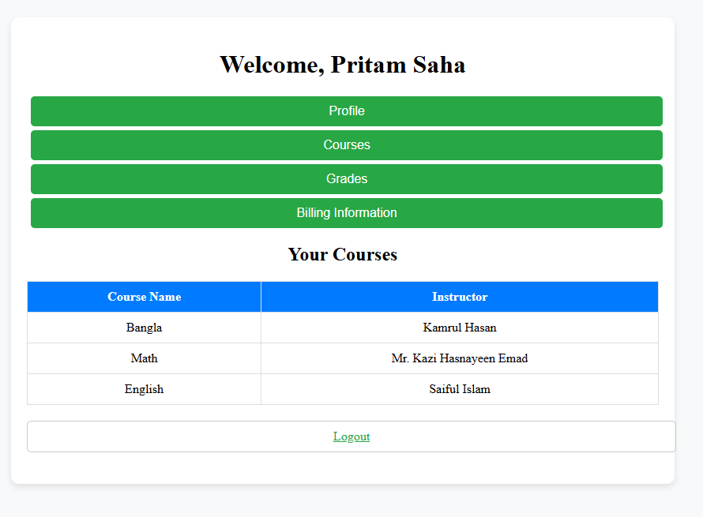
Result(4\5)
Figure 11: Profile Details
Figure 12: Course details
Student Portal
2

Slide 14
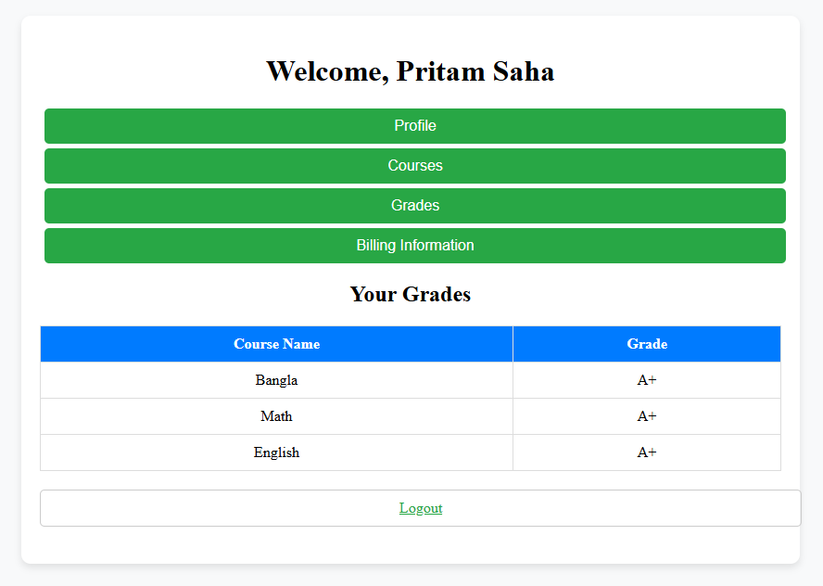
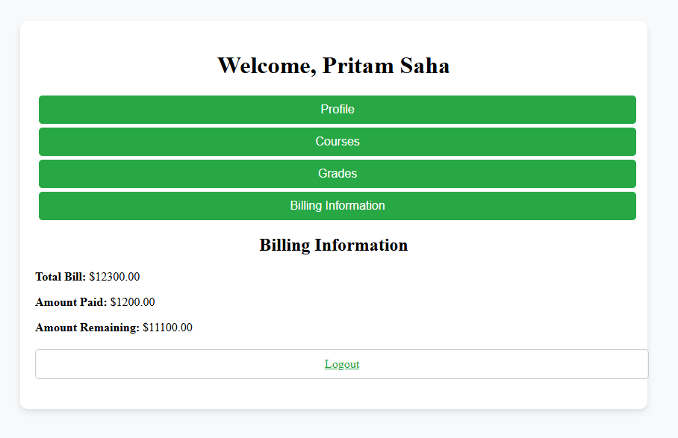
Result(5\5)
Figure 13: Course Grade
Figure 14: Billing Information
Student Portal
2

Slide 15
Future Scope of work
In future I will try to combine the features as followed
Separate authentication for different teachers
Language Localization
Analytics and Reporting
Integration with External Systems
Additional Features
Student Portal
2

Slide 16
Conclusion
The portal is designed with user-friendly interfaces, safe data processing, and flexibility in mind, making it more efficient for both students and administrators. It gives students real-time access to their academic data while decreasing administrative workload, resulting in a more visible and efficient academic environment
Student Portal
2

Slide 17
References
https://www.w3schools.com/html/
https://www.w3schools.com/css/
https://www.w3schools.com/js/
https://www.w3schools.com/php
https://www.youtube.com/@anisul-islam
MySQL Tutorial
Student Portal
2

Slide 18

Thank you ! Have a nice day !!
Student Portal

